Slide 1

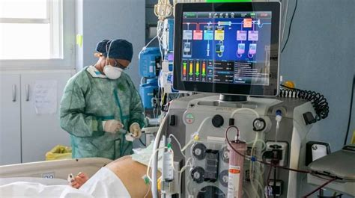

ICU SURVIVAL ANALYSIS
<Name>
<Date>
ACHIMUGU A.S
26-062022

Slide 2

Outline
Introduction
Methodology
EDA Results
Predictive Analysis
Deployment & Conclusion
Appendix
2
Notes:
<number>

Slide 3
Introduction
BUSINESS USE CASE
OBJECTIVES
In clinical practice, prediction of ICU mortality risk can be useful in
Triage and resource allocation
To determine appropriate levels of care
To prepare discussions with patients and their families around expected outcomes
Help policymakers identify useful policies
Create a model that uses data from the early hours of intensive care to predict patient survival with
Better prediction probability than apache
Minimize apache features
Transparent (easy to explain)
Generalizability Less complexity

Slide 4
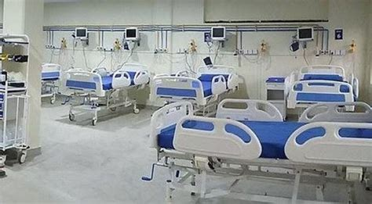
METHODOLGY
Data Collection
Data Cleaning
Data Visualisation
<Name>
<Date>
Data Pre Processing

Slide 5
Methodology
DATA
MIT's GOSSIS community initiative, with privacy certification from the Harvard Privacy Lab, provided the dataset of more than 90000 hospital Intensive Care Unit (ICU) visits from patients, spanning a one-year timeframe. The data is part of a growing global effort and consortium spanning Argentina, Australia, New Zealand, Sri Lanka, Brazil, and more than 200 hospitals in the United States. Dataset can be found here

Slide 6
Methodology
DATA
DATA DESCRIPTION
SOURCE
SHAPE
CATEGORY
MISSING
VALUES
MIT's GOSSIS
Rows 91713
Demographic
Rows 33%
Vitals
Columns 6%
147 Hospitals
Columns 85
Labs
6 Countries
Apache

Slide 7
Methodology
DATA CLEANING
Dropped Features:
That are irrelevants to the model or analysis e.g 'encounter_id', 'patient_id'.
With many missing rows that can’t be handled without affecting data authenticiy.
That are hihly corrollecte with each other e.g APACHE II and APACHE
III, d1_potassium_min and h1_potassium_min.
Impute:
Impute:
Fill the Nan of normal distributed columns with column mean
Replaced all CCU-CTICU CSICU CTICU with Cardiac ICU
Replaced all negative pre_icu_los_days with zero
Add features:
bmi_cat by grouping bmi into underweight, normal, overweight, obesed.
gcs_cat by adding gcs_eyes, gcs_motor, gcs_verbal and grouping into normal mild moderate and server.
Other created features include age_cat, h1_pluse_P, heart_rate_cat map_cat.

Slide 8
Methodology
DATA CLEANING
Dropped Features:
That are irrelevants to the model or analysis e.g 'encounter_id', 'patient_id'.
With many missing rows that can’t be handled without affecting data authenticiy.
That are hihly corrollecte with each other e.g APACHE II and APACHE
III, d1_potassium_min and h1_potassium_min.
Impute:
Impute:
Fill the Nan of normal distributed columns with column mean
Replaced all CCU-CTICU CSICU CTICU with Cardiac ICU
Replaced all negative pre_icu_los_days with zero
Add features:
bmi_cat by grouping bmi into underweight, normal, overweight, obesed.
gcs_cat by adding gcs_eyes, gcs_motor, gcs_verbal and grouping into normal mild moderate and server.
Other created features include age_cat, h1_pluse_P, heart_rate_cat map_cat.

Slide 9
Methodology
DATA VISUALISATION
Visualisation was done Seaborn Scatter plot, Bar plot, Piechart, Histogram and Boxplot.
Barplot:
Used to compare gender, ethnicity apache_3j_bodysystem, apache_2_bodysystem, bmi_cat, gcs_cat h1_pluse_P, map_cat, and heart_rate_cat.
Piechart:
Used to show percentage distribution of categories in hospital_death, icu_type.
Histtogram&
Boxplot:
Used to show the distribution and five point summary of age, bmi, height and weight.
Scatterplot:
Used to show the relationship betweenh1_mbp_max and d1_mbp_max.

Slide 10
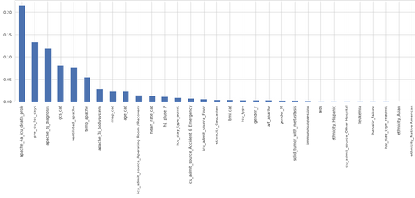
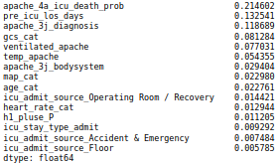
Methodology
DATA PREPROCESSING
Data Encoding
Ordinal categories such as gcs score, heart_cat, bmi_cat were label ecode while other categories were one hpt encoded.
Data
Oversampling
Imbalance in dataset was handle by random Oversampling of training data.
Feature
Selection
Feature selection was done using mutual infomation gain inother to get top features that contributed most to the target feature.

Slide 11
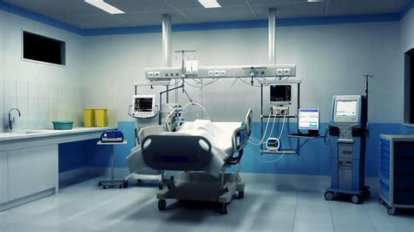
EXPLORATORY DATA ANALYSIS
<Name>
<Date>

Slide 12
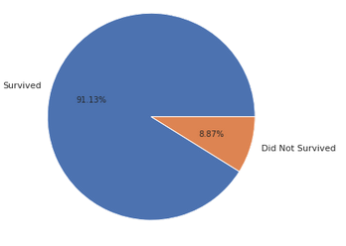
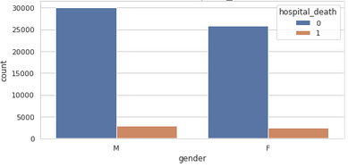
EDA with Data Visualization
Percentage Representation of hospital_death
Gender
The target feature (hospital_death) is highly imbalance with with a 91% survival rate and 9% non survival
They are 41898 male and 35746 female
They are 32817 female and 38423 male who suvrived while 3129 female and 3475 male did not.

Slide 13
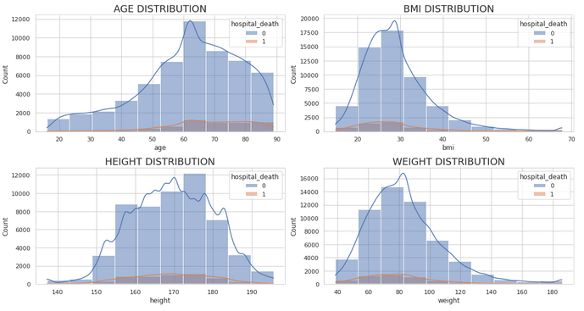
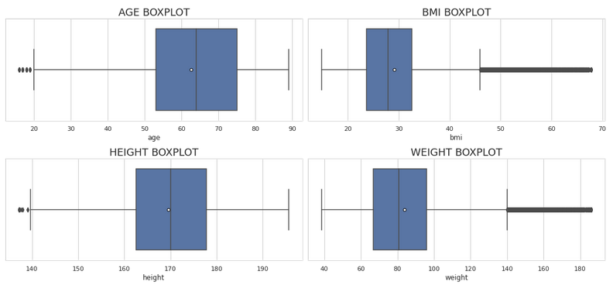
EDA with Data Visualization
Age, BMI, Weight and Height Distribution,Boxplot
Age seems to a little left skewed with few outlier
MI (body max index) and weight are right skewed with alot of outliers
Height has normally distribution.
The mean age, bmi, height and weight are 62.48, 29.15, 169.66cm and 83.98kg respectively.

Slide 14
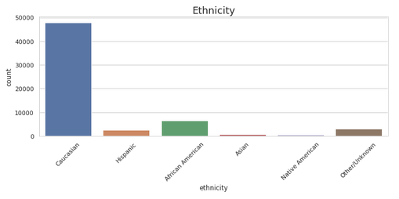
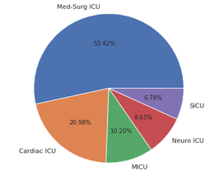
EDA with Data Visualization
Caucasian > African American > Hispanic > Asian > Native American
From the observation Med-Surg ICU provided the most care accounting for more than 50% of all ICU type.
Caucasian make 78% of the observation among total Ethnicity.
Cardiac ICU accounts for 21% of all ICU type.

Slide 15
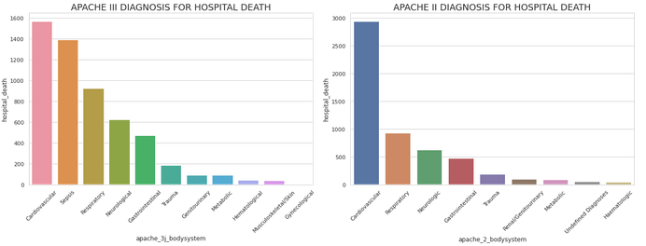
EDA with Data Visualization
The average length of stay of the patient between hospital ward admission and unit admission = 3.28 hours
In admission diagnosis for both APACHE III and APACHE II, Cardivascular disorder have the highest frequency for those who didnt survive
Respiratory conditons comes third in APACHE III after Sepsis and second in APACHE II
Gynecology and Heamatologic condictions account for least death for both the APACHE III AND APACHE II respectively.

Slide 16
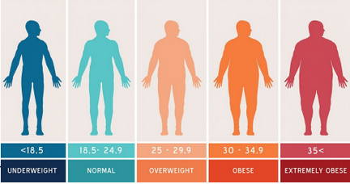
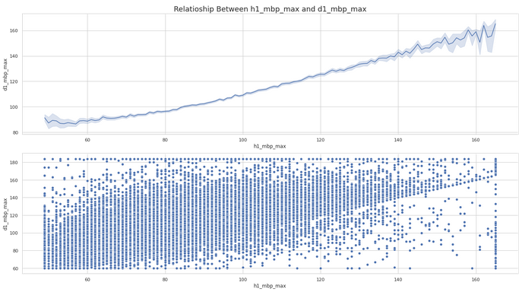
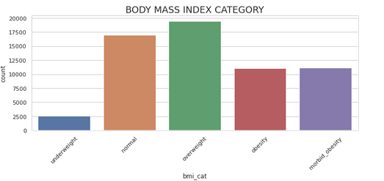
EDA with Data Visualization
BODY MASS INDEX CATEGORY
Relatioship Between h1_mbp_max and d1_mbp_max
They seem to be correlection between first hour mean blood pressure and 24 hour mean blood pressure
Most of the patient are overweight and above
27% of patient are normal BMI while 4% are underweight

Slide 17
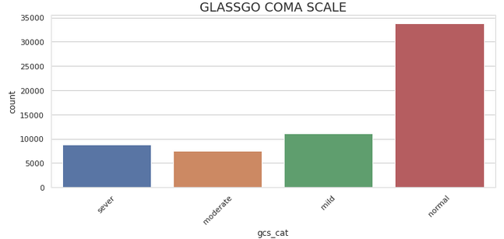
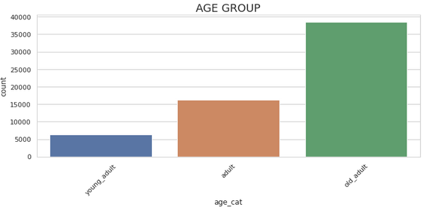

EDA with Data Visualization
63% patient from the observation are aged above 60 years old adults
55% were conscious while 45% has some level of impaired consciousness

Slide 18
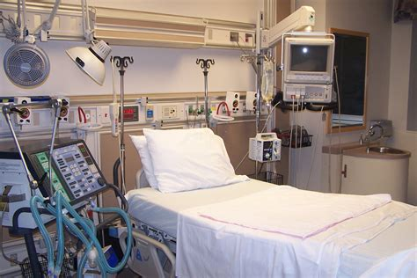
PREDICTIVE ANALYSIS
Models Training
Models Assement Criteria
Model Tuning
<Name>
<Date>
Model Evaluation

Slide 19
Predictive Analysis
Introduction
MODELS TRAINING
Classification algorithms used on data sets are
Logistic Regression Classifier
Decsion Tree Classifier
Random Forest Classifier
K Nearest Neighbour
Gradient Boosting Classifier
Light Gradient Boosting Classifier
<number>

Slide 20
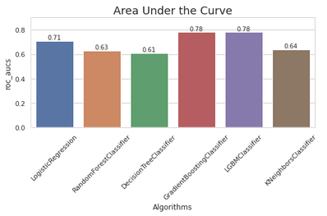
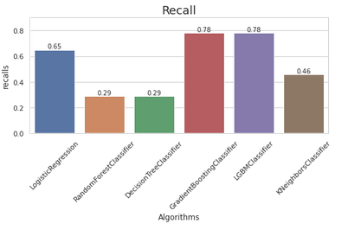
Predictive Analysis
MODELS ASSESSMENT CRITERIA
AUC Score:
Recall:
In imbalanced dataset False positive rate and true positive rate are more important than accuracy
Recall measures the ability of a model to detect positve samples.
From the graphs above, Gradient Booster classifer and Light Gradeint Booster has the highest area under the curve of 0.78 on test data and a recall of 0.78with default parameter. Both algorimthms will be tunned with different parameter for best scores

Slide 21
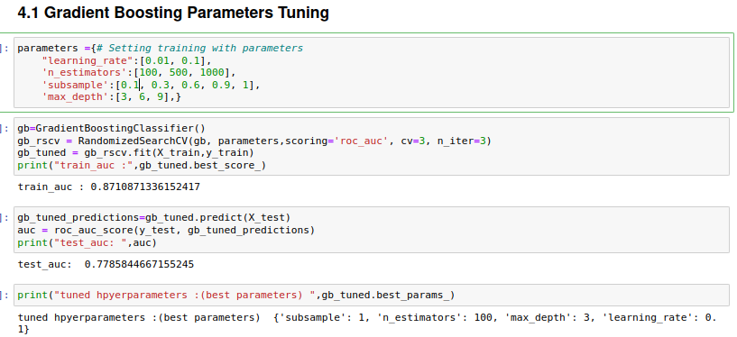
Predictive Analysis

Slide 22
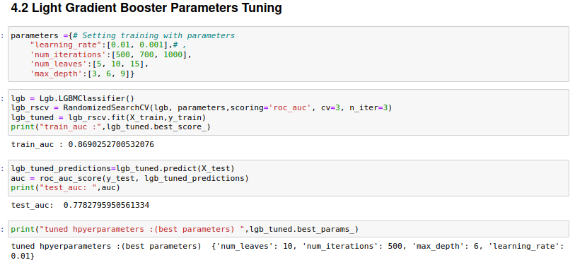
Predictive Analysis

Slide 23
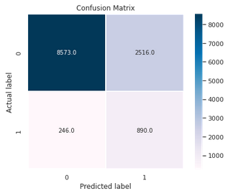
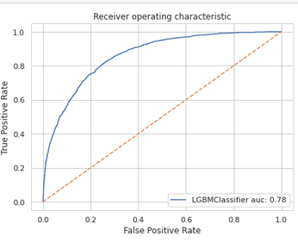
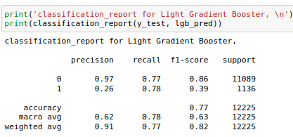
Predictive Analysis
Best model metrics
AUC
Train
Test
0.86
0.78
RECALL
0.78
Advantages of Light Gradient boosting
Faster traning time
Lower memory usage
Support parrallisation on distributed systems
Comment: No sign of overfitting.

Slide 24
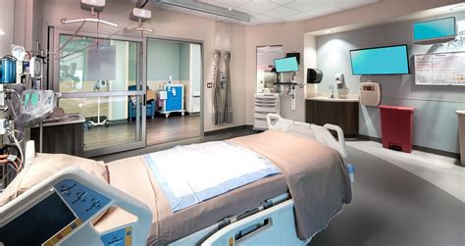
Introduction
DEPLOYMENT
&
CONCLUSION
<Name>
<Date>
<number>

Slide 25

Deployment & Conculsion
After data proccessing and fitting with different classifiers, Both light Gradient Boosting Classifier Gradient Boosting Classifier peformed best among other classifer with a roc_auc of 0.78 and recall of 0.78. - - - Light Gradient Boosting model was be safed as lgb_model.pkl and deployed on the with Django and free Heroku
Section 1
<number>

Slide 26
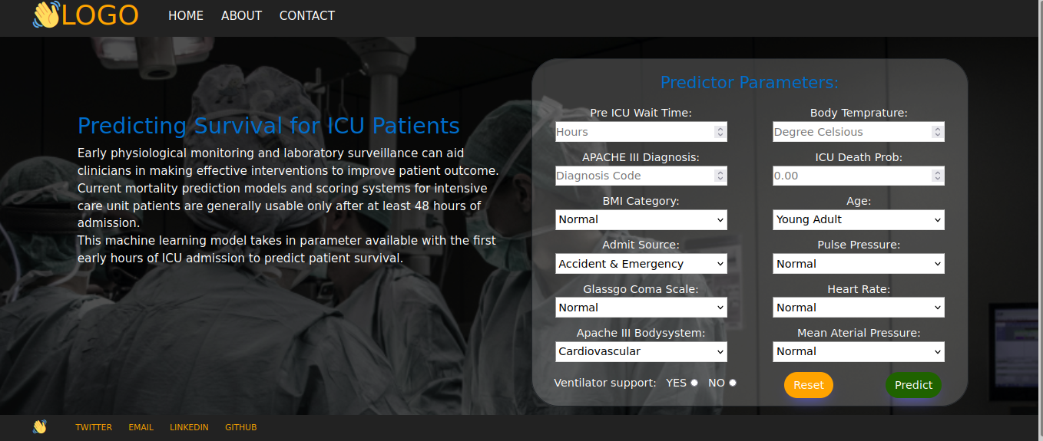
Web Deployment
Place your flowchart of web scraping here
<number>

Slide 27
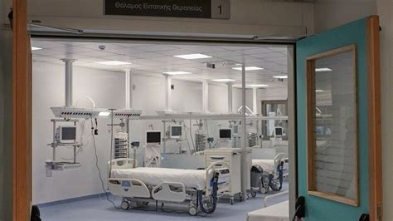
Introduction
APPENDIX
<Name>
<Date>
<number>

Slide 28
DICTIONARY
AUC: Area U nder The Curve
ICU: Intensive Care Unit
EDA: Exploratory Data Analysis
APACHE Acute physiological And Chronic Health Evaluation
BMI Body Mass Index
h1_mbp_max: One Hour Maximum Mean Blood Pressure
Med-Surg ICU: Medical and Surgical Intensive Care Unit
map_cat: Mean Aterial Pressure
CCU Critical Care Unit
CSICU Cradiac surgey intensive care unit
CTICU Cardiothrocic Intensive Care Unit

Slide 29
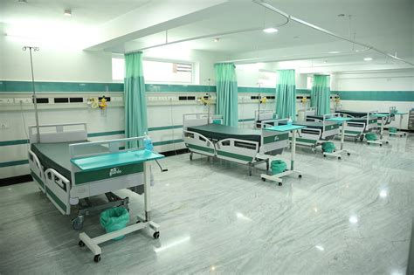
0
THANK YOU
<Name>
<Date>
<number>

